Slide 1

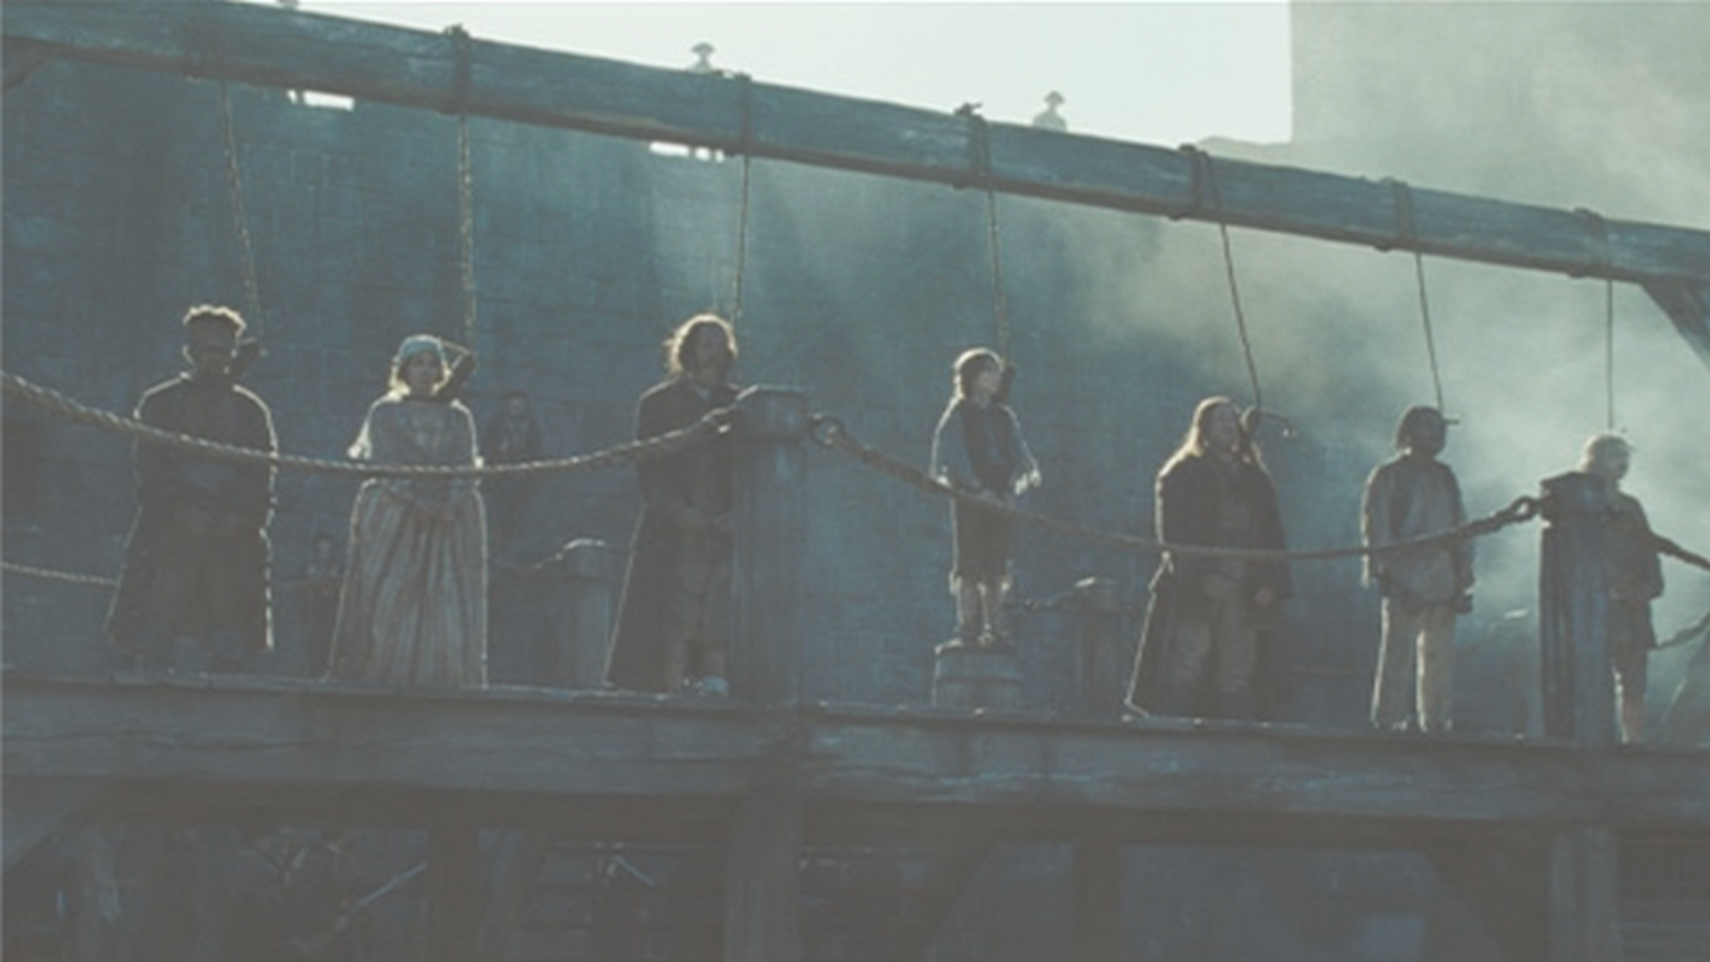


450 BC - Present
Chapter 34
PATTERNS OF CHANGE IN CRIME AND PUNISHMENT
patterns of change in crime and punishment
Strand Two & Three: The History of the World
@MsDoorley

Slide 2



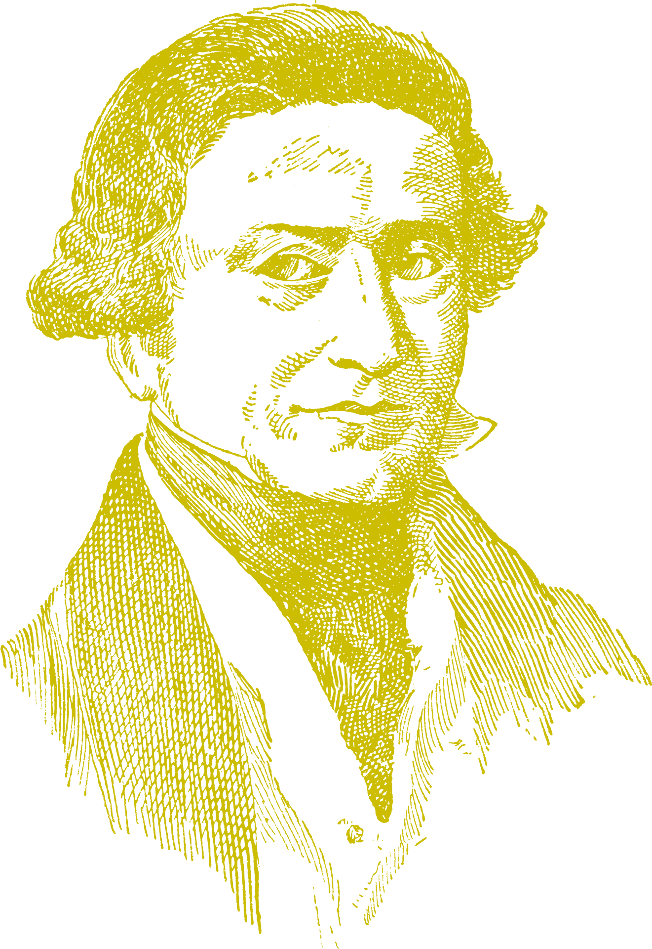











Chapter 34
PATTERNS OF CHANGE:
CRIME AND PUNISHMENT
Romans invade Britain - legionaries are responsible for finding criminals.
Highwaymen - the invention of the pistol allowed Highwaymen to threaten traders
Police ('Bobbies' or 'Peelers') set up by Sir Robert Peel.
Strand Two & Three: The History of the World
Chapter Thirty-Four: Patterns of Change in Crime and Punishment
450 BC
AD 43
AD 410
17th C.
1823
1829
21st C.
Twelve Tables - Roman laws which outlined the basic rights for all Roman peoples
Wergild - payment system used in Anglo-Saxon times to settle disputes
Gaols Act start a reform of prisons while a further 90 prisons built between 1842-1877.
DNA testing, CCTV cameras, use of fingerprints and alarms to help prevent & detect crime.
@MsDoorley

Slide 3
Learning Outcomes
3.11 EXPLORE the contribution of technological developments and innovation to historical change
3.14 ILLUSTRATE patterns of change across different time periods in a chosen theme relating to life and society (such as, Crime and punishment; Food and drink; Work and leisure; Fashion and appearance or Health and medicine).
Strand Two & Three: The History of the World
Chapter Thirty-Four: Patterns of Change in Crime and Punishment
@MsDoorley

Slide 4
Introduction
A pattern of change in history is how changes occur in a particular area of history over a period of time. In this chapter, we will focus on how the ideas and practices around crime and punishment have changed over time. These changes, which include laws and how society thinks about right and wrong, offer a detailed look into the values and rules of different times in history. We will identify key moments when major changes happened in the laws or in how punishment was given. Throughout history, we have seen important changes in what is considered a crime, how laws are made, and how people are punished or helped to change their behaviour. Recognising what drives these changes, such as new technologies or changing beliefs, helps us understand not only the past but also the world we live in today.
Strand Two & Three: The History of the World
Chapter Thirty-Four: Patterns of Change in Crime and Punishment
@MsDoorley

Slide 5
450 BC - Present
Chapter 34
34.1: CRIME AND PUNISHMENT IN ANCIENT TIMES
34.1: crime and punishment in ancient times
Strand Two & Three: The History of the World
@MsDoorley

Slide 6
Who Made The Law?
The Romans had a written code of law (the Twelve Tables) which were made by the emperors and the Senate, outlining what Romans could do legally. Rather than a police force, soldiers were responsible for keeping order. Vigiles (firefighters) patrolled the streets at night to watch out for fires and to prevent crimes. Courts ruled on guilt or innocence. In serious crimes, people were entitled to a trial by jury while less serious crimes were tried before a magistrate (judge). Romans had to catch the criminal and bring them to trial, with victims collecting their evidence.
Strand Two & Three: The History of the World
Chapter Thirty-Four: Patterns of Change in Crime and Punishment
@MsDoorley

Slide 7
What Were The Crimes?
Rome was a very crowded city with a distinctive division between the patricians and the plebians which resulted in crimes such as robbery and burglary. Other minor crimes included fraud in trade, such as cheating about goods that were sold. More serious crimes included arson and murder. Due to the number of slaves in Ancient Rome, slaves running away was a crime. Being Christian was also regarded as a crime until Emperor Constantine’s conversion to the religion on his deathbed.
Strand Two & Three: The History of the World
Chapter Thirty-Four: Patterns of Change in Crime and Punishment
@MsDoorley

Slide 8
What Were The Punishments?
Punishments for crimes were serious in order to act as a deterrent (discouragement) to commit future crimes and often depended on one’s societal position, with patricians treated better than plebians. Citizens of Rome were treated better than non-citizens while slaves were treated the worst of all. Plebians got flogged (whipped) or were fined for small crimes. For more serious crimes such as murder, they were executed by hanging or beheading.
Patricians were unlikely to commit small crimes due to their financial standings. For serious crimes such as revolts against the government, they were executed, crucified or sent into exile to some other parts of the empire. Slaves were treated harshly, usually be crucifixion or fighting in combat. There were also harsh punishments in the army in order to impose discipline. Decimation was when every tenth soldier could be taken out for execution.
Strand Two & Three: The History of the World
Chapter Thirty-Four: Patterns of Change in Crime and Punishment
@MsDoorley

Slide 9
Questions pg. 479 (Making History, 2nd Edition)
  What were the Twelve Tables?
  Who kept order in Ancient Rome?
  Who patrolled the streets at night?
  List two crimes in Ancient Rome.
  Who collected evidence when a crime was comitted?
  Who was tried before a magistrate?
  What was a deterrent?
  Explain how punishment in Ancient Rome often depended on your position in society.
  How were soldiers punished?
Strand Two & Three: The History of the World
Chapter Thirty-Four: Patterns of Change in Crime and Punishment
@MsDoorley

Slide 10
450 BC - Present
Chapter 34
34.2: CRIME AND PUNISHMENT IN THE MIDDLE AGES
34.2: crime and punishment in the middle ages
Strand Two & Three: The History of the World
@MsDoorley

Slide 11
Who Made The Law?
The king and local lords made the laws; a crime was any activity that broke the king’s law.
As England came under one king, the King’s peace was extended over the whole country so the same laws were applied everywhere. This became the basis of English common law.
Strand Two & Three: The History of the World
Chapter Thirty-Four: Patterns of Change in Crime and Punishment
@MsDoorley

Slide 12
Who Enforced The Law?
Most communities or villages, the people enforced the law as there was no police. If a person saw a crime being committed, they could cry out for help (hue and cry). Other people in the village, led by the parish constable, came to their help to catch the criminal. If that failed, the sheriff had the job of catching the criminial.
Night-time in medieval times was dangerous as there was no public lighting. A watchman was paid to patrol the streets while a curfew was in place which forced people to extinguish all fires and remain indoors.
Criminals were tried in local courts or by the lord of the area in manor courts. There was also trial by ordeal (the innocent would survive the pain of hot fire or iron, hot water or cold water) or trial by combat (the winner of the combat was proven right or innocent).
In an attempt to get rid of the trials, the king organised judges to travel around the country in royal courts to try certain crimes as well as appointing justices of the peace in each county. They had the power to fine and arrest people for breaking the peace.
There were also Church Courts which were more lenient that the royal courts. Priests claimed the benefit of the clergy, as did lay people who could read the bible.
Some people claimed sanctuary where they could be protected by the Church, giving them the chance to leave the country rather than be tried by the king’s courts.
Strand Two & Three: The History of the World
Chapter Thirty-Four: Patterns of Change in Crime and Punishment
@MsDoorley

Slide 13
What Were The Crimes?
Most crimes were small – damage to property, minor theft or poaching. Violent crimes such as murder were rare while a rise in crime was often seen after seasons of bad harvest.
Crimes against the People | Crimes against property | Crimes against the King
Murder | Arson | Treason
Assault | Theft | Rebellion
Rape | Poaching
Strand Two & Three: The History of the World
Chapter Thirty-Four: Patterns of Change in Crime and Punishment
@MsDoorley

Slide 14
What Were The Punishments?
There were no prisons to hold criminals for punishments but rather to hold people temporarily before they went to trial.
Minor crimes were usually dealt with by fines, floggings or public humiliation.
Public humiliation involved people were placed in timber frames such as stocks (sitting down) or pillories (standing up) for everyone to see and were permitted to throw objects, such as rotten food, at them.
Serious crimes such as murder or treason or serious theft were punished severely. Thieves could have their hands cut off or publicly executed (by hanging or beheading) to serve as a deterrent to others.
Under the law, women were treated as inferior. Women were punished for scolds (gossip), as sex workers or they were classified as witches. The ducking stool (women were tied to a chair at the end of a long timber beam and ducked in and out of a nearby river) was used as for women’s punishment.
Women who committed murder were strangled.
Strand Two & Three: The History of the World
Chapter Thirty-Four: Patterns of Change in Crime and Punishment
@MsDoorley

Slide 15
Questions pg. 482 (Making History, 2nd Edition)
  Who made the laws in medieval times?
  What was hue and cry?
  What did a watchman do?
  What was a curfew?
  What was the difference between trial by ordeal and trial by combat?
  Why did people prefer to be tried in a Church Court in the Middle Ages?
  What was sanctuary?
  List one crime (i) against people (ii) against property (iii) against the king in medieval times.
  How were people punished for (i) minor crimes (ii) serious crimes?
  How were women punished?
Strand Two & Three: The History of the World
Chapter Thirty-Four: Patterns of Change in Crime and Punishment
@MsDoorley

Slide 16
450 BC - Present
Chapter 34
34.3: CRIME AND PUNISHMENT IN INDUSTRIAL SOCIETY
34.3: crime and punishment in industrial society
Strand Two & Three: The History of the World
@MsDoorley

Slide 17
Who Made The Law?
During the 18th and 19th centuries, laws were made in Britain by parliament and signed into the constitution by the King or Queen. The governments looked on punishment as a deterrent to stop people committing crimes.
More and more of Britain’s rising population began to live in towns and cities, the rich began to live in suburbs while the poor lived in overcrowded conditions in the city centres. This change was accompanied by increasing crime, drunkenness and violence.
Prior to the Industrial Revolution, over 200 offences such as sheep-stealing, poaching and theft were considered capital offences which, as Britain operated under the Bloody Code, crimes punishable by hanging. As crime continued to rise, new changes were needed.
John Howardand Elizabeth Fry advocated changes in the prison system while Sir Robert Peel began the process of change in Westminster.
Strand Two & Three: The History of the World
Chapter Thirty-Four: Patterns of Change in Crime and Punishment
@MsDoorley

Slide 18
Who Enforced The Law?
One such change was the introduction of the first professional police force, the Peelers, in 1829 who were armed with only a baton or truncheon and their main job was to patrol the streets to prevent crime. Specialist detective sections were set up to solve crimes.
Strand Two & Three: The History of the World
Chapter Thirty-Four: Patterns of Change in Crime and Punishment
@MsDoorley

Slide 19
Questions pg. 457 (Making History, 2nd Edition)
  Who made the laws in 18th Century Britain?
  How many offences had hanging as a punishment?
  Name two people who promoted prison reform.
  How did they say prisons should be reformed?
  Who was the Home Secretary who promoted changes in prison conditions?
  Why did some Members of Parliament (MPs) oppose improvements in prison conditions?
  What change did Robert Peel introduce in policing?
Strand Two & Three: The History of the World
Chapter Thirty-Four: Patterns of Change in Crime and Punishment
@MsDoorley

Slide 20
What Were The Crimes?
Some of the old crimes, such as poaching, became less important, but newer crimes developed in this rapidly changing society. These crimes included bank robbery, as more banks were set up, or thefts from the workplace as more goods were being traded.
  There was also white-collar crime (crime committed by business and finance professionals) of corruption, fraud and cheating.
  But the close living conditions of the time resulted in petty theft being the most common crime.
Strand Two & Three: The History of the World
Chapter Thirty-Four: Patterns of Change in Crime and Punishment
@MsDoorley

Slide 21
What Were The Punishments?
Transportation was introduced in 1787 which saw criminals transported to Australia where they worked for the settlers for seven years, providing free labourin exchange for free food and boarding. Most prisoners would stay in Australia after they served their time as they could not afford the passage home. By 1868, over 160,000 people had transported to Australia.
Pre-Industrial Revolution, prisons were only used to hold people awaiting trial. Conditions were poor as all types of prisoners were grouped together in one space while disease spread quickly.
Sir Robert Peel began the process of prison reform with the Gaols Act in 1823 which meant prisoners would now be separated by gender and category of crime. It also introduced paid wages for gaolers and the removal of chains for prisoners.
90 new prisons were build between 1842 and 1877 while life was made more difficult for the prisoners through the two new organisation systems.
  The Separate System – prisoners were kept in their own cells
  The Silent System – hard labour in silence (‘hard labour, hard fare and hard board’)
Strand Two & Three: The History of the World
Chapter Thirty-Four: Patterns of Change in Crime and Punishment
@MsDoorley

Slide 22
Questions pg. 457 (Making History, 2nd Edition)
  What new crimes were committed in a rapidly changing society?
  What was the most common crime in the 19th Century?
  How did people view punishments of criminals?
  Did people favour hangings as a punishment?
  Where did Britain transport criminals?
  What did they do in that country?
  Name one term of the Gaols Act, 1823.
  Name the first of the 90 new prisons built in England.
  What was (i) the separate system and (ii) the silent system?
  Why were public hangings banned?
Strand Two & Three: The History of the World
Chapter Thirty-Four: Patterns of Change in Crime and Punishment
@MsDoorley

Slide 23
450 BC - Present
Chapter 34
34.5: CRIME AND PUNISHMENT IN THE TWENTIETH CENTURY
34.5: crime and punishment in the twentieth century
Strand Two & Three: The History of the World
@MsDoorley

Slide 24
Who Made The Law?
There have been many factors which have influenced crime and punishment during the 20th and the 21st centuries:
1.Social changes and divisions: conflict between different groups in society
2.Economic change: greater gap between rich and poor
3.Rising expectations of consumer society: advertising has created expectations with people wanting televisions, household appliances, cars, etc.
4.Growth of cities and towns: more opportunities to commit crime as people have become unknown to each other.
5.Public opinion: harsher punishments while feelings stirred up by some politicians and medias communicate with each other and store information on databases.
Strand Two & Three: The History of the World
Chapter Thirty-Four: Patterns of Change in Crime and Punishment
@MsDoorley

Slide 25
Who Enforced The Law?
There were many changes in policing during the 20th Century. These changes were necessary for police to keep up with changes in crime.
  Police became motorised. This allowed police to cover wide areas, but it took the policemen or women on the beat (regularly patrolling a certain area) off the streets.
  Police remained unarmed in Britain (and Ireland) except for batons, pepper sprays and tasers but some units were armed with guns to deal with more aggressive criminal gangs.
  Some police became specialised such as Drug Units, Fraud Squad, and Traffic Control.
  Membership of the police forces has changed to ensure places for men and women, and also to reflect different ethnic and religious groups in society.
  Police also use Neighbourhood Watch to encourage communities to look out for their members.
Police have used the benefit of science and technology to catch and prosecute criminals. This includes fingerprinting (1901) and DNA testing in the late 20th Century, CCTV, radios and computers to communicate with each other.
Strand Two & Three: The History of the World
Chapter Thirty-Four: Patterns of Change in Crime and Punishment
@MsDoorley

Slide 26
Questions pg. 486 (Making History, 2nd Edition)
  Explain decriminalising.
  Name one sensational headline on a crime story.
  How did motorising the police help them combat crime.
  What weapons did police in Britain carry with them in the 20th century?
  Name a specialised police unit.
  Why did membership of the police force change?
  What was the Neighbourhood Watch?
  Name one way in which science and technology helped the police fight crime.
Strand Two & Three: The History of the World
Chapter Thirty-Four: Patterns of Change in Crime and Punishment
@MsDoorley

Slide 27
What Were The Crimes?
During the first half of the 20th Century, British crime figures were low (mainly due to the two World Wars) before rapidly increasing from the 1960s onwards.
Many crimes are variations of older crimes such as cybercrimes of online theft and fraud. The problem with these were that they are often located abroad.
Terrorism got more notice during the later decades of the 20thcentury but it was not a new crime. The IRA bombing campaign In Britain during the Troubles was similar to the actions of the Fenians in the 19th Century.
As society has changed, new crimes have emerged. In the new multi-cultural society, new laws have been created to protect different groups based on race, religion and/or sexuality. This included the Race and Religious Hatred Act (2006) which has made it an offence to incite hatred against a person on the grounds of their religious or racial background.
There have also been new drug laws brought in as wide drug use affected society.
As cars have become more common, new laws have been brought into place in order to control their use. This includes laws regarding speeding, breaking traffic lights, driving under the influence of alcohol/drugs and driving while using a phone.
Due to changing society, some of the criminal acts which have been abolished include the decriminalising of homosexuality (Britain in 1967 and Ireland in 1993) and abortion in certain circumstances (Britain in 1967 and Ireland in 2018).
Strand Two & Three: The History of the World
Chapter Thirty-Four: Patterns of Change in Crime and Punishment
@MsDoorley

Slide 28
What Were The Punishments?
The reforms made in prisons in the Industrial Revolution were further changed, or in some cases dropped completely. It was hoped prisons would reform people to being better humans.
The separate system was dropped while the hard work was reduced before being abolished.
Prisoners were allowed ordinary haircuts and clothing rather than the shaven heads and the prisoners could earn some money.
Workshops were set ip so that there were more opportunities for work and prisoners could earn some money; they were also allowed more family visits.
The death penalty (capital punishment) was completely abolished in Britain in 2004.
Prison conditions became more difficult from 1960 onwards, leading to riots in the 70s and 90s.
New punishments were introduced rather than relying on prisons. Some people could get probations for minor offences with Community Service Orders and electronic tagging becoming common.
Juvenile courts have been set up to deal with young offenders while youth detention centres have also been set up. However, re-offending rates continue to be high.
Strand Two & Three: The History of the World
Chapter Thirty-Four: Patterns of Change in Crime and Punishment
@MsDoorley

Slide 29
Questions pg. 488 (Making History, 2nd Edition)
  When did crime figures rise during the 20th century in Britain?
  Give one example to show how crime fgures rose.
  Explain 'Many crimes were variations on older crimes'.
  What new laws were passed to protect different groups in society?
  Give one example of a new law about the use of cars.
  Give one example of a law that was decriminalised.
  Give one example to show how prisons were managed differently to the 19th century.
  Why was the death penalty abolished in Britain in 2004?
  Give one new punishment that was introduced instead of sending people to prison.
  What was the Borstal system? What replaced the Borstal system?
Strand Two & Three: The History of the World
Chapter Thirty-Four: Patterns of Change in Crime and Punishment
@MsDoorley

Slide 30
450 BC - Present
Chapter 34
34.6: SUMMARY
34.6: summary
Strand Two & Three: The History of the World
@MsDoorley

Slide 31
In this chapter, we have learned that...
  In the ancient world, crime and punishment were primarily guided by the edicts of emperors and the Roman Senate. Soldiers and the Vigiles served as law enforcement, and punishment was often influenced by one's social class. The focus was largely on physical penalties for crimes ranging from robbery to more serious offenses like murder and arson.
  During the Middle Ages, laws were often made by the King and local lords. There was no formal police force; rather, law enforcement was a community responsibility. Crimes commonly involved property damage and poaching, with punishments varying from fines to public humiliation and even execution.
  In the eighteenth and nineteenth centuries, Britain's legal system underwent significant changes. Laws were created by parliament and ratified by the monarchy. With industrialisation, new forms of crime emerged, including white-collar crimes and bank robberies. Influential figures like John Howard and Elizabeth Fry advocated for prison reform, and transportation to Australia became a notable form of punishment.
  In the twentieth century, lawmaking was influenced by various social, economic, and technological factors. Police forces adapted to these changes, employing new technologies like fingerprinting and DNA testing. Crimes evolved to include cybercrimes and terrorism, while legal systems also adapted to protect increasingly diverse populations based on race, religion, and sexuality. The focus of punishments also shifted towards rehabilitation, with new measures like community service orders and electronic tagging being introduced.
  Throughout human history, the justice system has reflected societal norms and advanced along with changes in technology, economics, and social structures. By the twentieth century, many countries had moved towards making legal systems more equitable, mirroring broader welfare state principles, although disparities still exist.
Strand Two & Three: The History of the World
Chapter Thirty-Four: Patterns of Change in Crime and Punishment
@MsDoorley

Slide 32
Reflecting on... Patterns of Change in Crime and Punishment
The human quest for order and justice has evolved significantly through time. In earlier societies, justice was largely determined by might or social status, with little formal process. The Industrial Revolution brought sweeping changes in social dynamics and crime rates, prompting the need for legal reforms and the creation of organised police forces. In the twentieth century, advancements in technology and a changing social fabric have required law enforcement to adapt, shifting focus toward rehabilitation and more equitable systems. Much like the advancement of medical care, the journey toward a just society has been gradual but consistent, adapting to meet the challenges of each new era.
Strand Two & Three: The History of the World
Chapter Thirty-Four: Patterns of Change in Crime and Punishment
@MsDoorley

Slide 33
Examination Questions
Strand Two & Three: The History of the World
Chapter Thirty-Four: Patterns of Change in Crime and Punishment
@MsDoorley

Slide 34
Project
Guidelines:
  Length: The depth of your project should reflect about 2-3 weeks of work.
  Sources: Use at least three different sources for your research. These can be books, scholarly articles, or reputable online resources.
  Citations: All information and images that are not your own should be properly cited.
  Mediums: You may choose to present your project in one of the following ways:
    Poster: Your poster should be informative and visually engaging.
    Minecraft or Lego Model: If choosing this option, please also include a brief report explaining your model.
    Painting/Drawing: Your artwork should be accompanied by a description.
    Recycled Materials: Create your model using recycled materials and provide an explanation of your creative process.
Assessment:
Your projects will be assessed based on:
  Research and Content
  Creativity and Presentation
  Understanding of Context
  Adherence to Guidelines
Strand Two & Three: The History of the World
Chapter Thirty-Four: Patterns of Change in Crime and Punishment
@MsDoorley

Slide 35
Project
Historical Sites
Historical Figures
Alcatraz, San Francisco, California, USA
Tower of London, England
Eastern State Penitentiary, Philadelphia, Pennsylvania, USA
Robben Island, South Africa
International Criminal Court, The Hague, Netherlands
Cesare Beccaria
Jeremy Bentham
Sir Robert Peel
Elizabeth Fry
Michel Foucault
Al Capone
Eliot Ness
William Blackstone
Sigmund Freud
Clarence Darrow
Ruth Bader Ginsburg
Nelson Mandela
Strand Two & Three: The History of the World
Chapter Thirty-Four: Patterns of Change in Crime and Punishment
@MsDoorley

